Slide 1
UL9540 Overview:
Safety for Energy
Storage Systems
Ken Boyce
Principal Engineer Director
Energy & Power Technologies
UL LLC

Slide 2
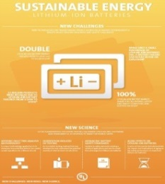
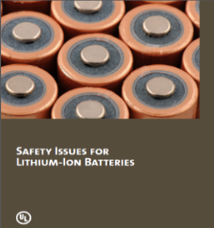
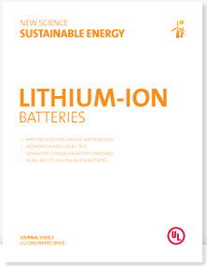



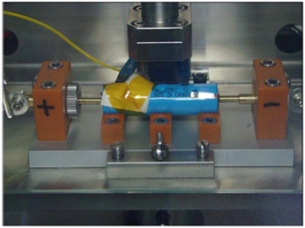

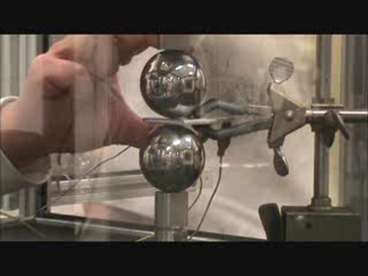
Leader in Advanced Battery Safety Science
Research
Thought Leadership
Battery Standards
Testing & Certification
Design Advisory
UL 1973: Stationary Applications
UL 2580: Electric Vehicles
UL 2271: Light Electric Vehicles
UL 2272: Electrical Systems for Self-
Balancing Scooters
UL 810A: Electrochemical Capacitors
UL 2743: Portable Power Packs
UL 9540: Energy Storage Systems
UL 3100: Distributed Energy
Generation and Storage Systems

Slide 3
Battery Science converted to UL 9540
UL originally published UL 9540 in 2014 to address safety of energy storage systems
The work was based on our extensive safety science and engineering efforts to effectively mitigate potential hazards for energy storage systems
The requirements address the inherent design and performance, as well as the interface of the energy storage system with the infrastructure

Slide 4
UL 9540 - Scope
Scope includes:
Standalone to provide energy for local loads; or
In parallel with an electric power system, electric utility grid; or
Able to perform multiple operational modes.
For use in utility-interactive applications in compliance with IEEE 1547 and IEEE 1547.1 or
Other applications intended to provide grid support functionality,
May include balance of plant and other ancillary equipment of the system
energy storage systems that are intended to receive electric energy and then to store the energy in some form to provide electrical energy to loads or power conversion equipment when needed
The systems covered can be:
UL and the UL logo are trademarks of UL LLC © 2015
Notes:
The scope of UL 9540 of course is energy storage systems that are either standalone, grid interactive or multi-mode. The standard includes the technology, the equipment for connection to the grid or standalone system and the balance of plant equipment of the system such as chargers for batteries or pumps for flow battery systems, etc..

Slide 5
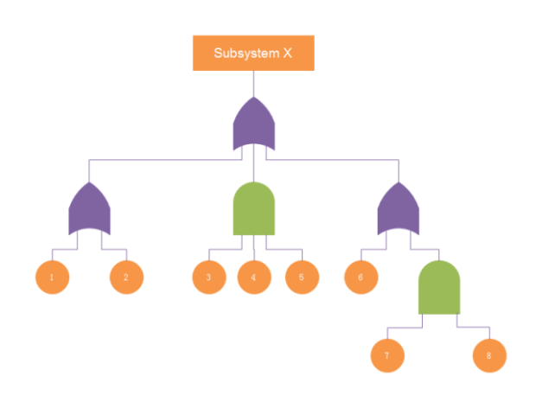
UL 9540 Safety Approach

Slide 6
UL 9540 Scope
Technology | Input Energy Conversion Mechanism | Energy Storage Mechanism | Output Energy Conversion Mechanism
Electrochemical | Charger | Battery | Converter
Chemical | Water Electrolysis H2 Generator | Hydrogen Storage | Fuel Cell
Mechanical | Air Compressor | Flywheel | Motor Generator
Thermal | Heat Pump | Thermal Storage | Heat Generator

Slide 7
Potential Hazards Associated with Energy Storage Systems
What are the potential hazards associated with ESSs?
Energy
Fire
Explosion
Electrical
Electric shock
Mechanical
Pressure
Noise
Chemical
Toxic or hazardous substance exposure/ concentrations
Moving parts
Burns
Sharp edges
Arc Flash
Electrical burns
Notes:
Potential hazards associated with energy storage systems including hazards associated with energy such as fire, explosions and burns, electrical shock hazards, mechanical hazards such as high pressure and moving parts and chemical hazards such as toxic or hazardous substances

Slide 8
Safety Analysis Approach
Energy storage systems shall be provided with a safety analysis such as, but not limited to:
A failure modes and effects analysis (FMEA) that identifies critical safety components and circuits of the system shall be provided.
The analysis shall consider the compatibility of the parts of the energy storage system with regard to safety of the overall system.
Electronics and software controls determined to be critical for safety
evaluated for functional safety to an appropriate safety integrity level (SIL) or
similar safety classification for the system as determined by the system safety analysis

Slide 9
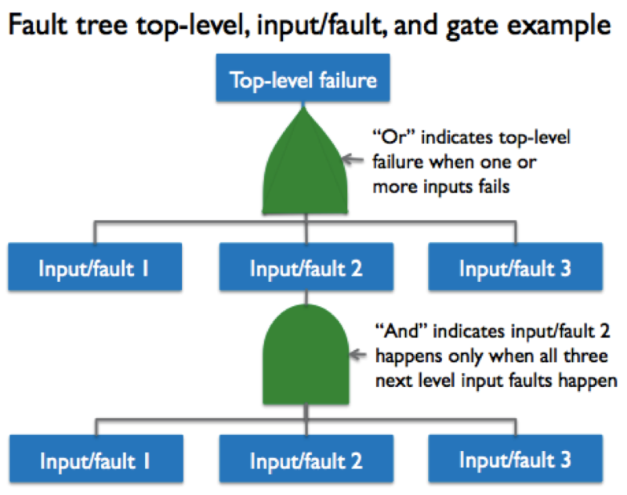
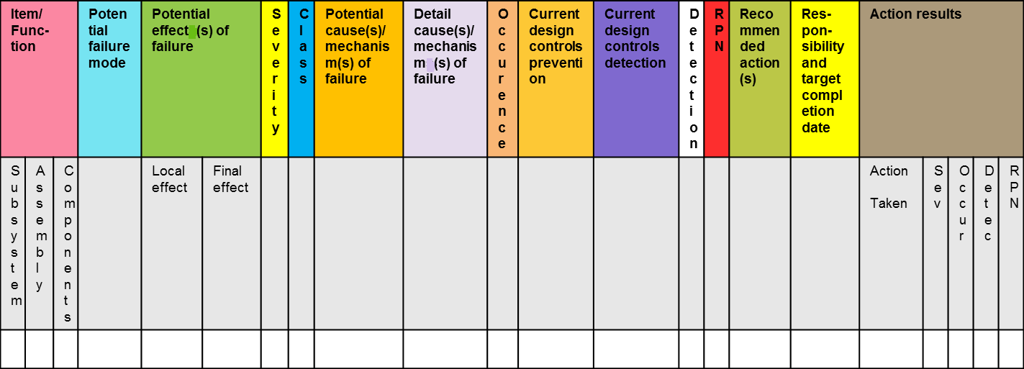
Safety Analysis Approach
FTA is a top down analysis
FMEA is a bottom up analysis

Slide 10
Referenced Critical Standards
UL 1973, Batteries for Use in Light Electric Rail (LER) and Stationary Applications
UL 1741, Inverters, Converters, Controllers and Interconnection System Equipment for Use With Distributed Energy Resources
ASME B31, Power Piping Codes
ASME B & PV, Boiler and Pressure Vessel Code
ASHRAE 62.1, Ventilation for Acceptable Indoor Air Quality
CSA FC 1, Fuel Cell Technologies – Part 3-100: Stationary Fuel Cell Power Systems – Safety
IEEE C2, National Electrical Safety Code
NFPA 70, National Electrical Code (NEC)

Slide 11
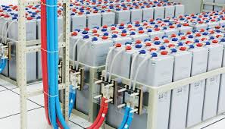
Construction Criteria
Notes:
UL has developed a safety standard, UL 9540 with a safety approach that focuses on mitigating the hazards associated with various forms of energy storage.

Slide 12
Overview of UL 9540 Construction Criteria
Enclosure & Electrical Insulation Materials -
Enclosure Ratings –
Plastic Materials
5VA minimum flame rating for plastic enclosures
Comply with either UL 746C or C22.2 No. 0.17
For enclosures or insulation
UV rating for enclosure if exposed to sunlight
Metallic Materials
Resistant to corrosion
Openings evaluated per IEC 60529 rating
Minimum rating IP2X unless intended for Restricted Access Locations
Outdoor enclosure ratings evaluated
Notes:
UL 9540 includes construction requirements for enclosures and guarding of hazardous parts, electrical requirements such as reference to the NEC or NESC depending upon the location of the energy storage system.
There are reference to standard such as the ASME B31 series of piping standard and the B & PV code to address fluid handling and containment.
The standard also address fire detection and suppression, which is critical for large systems and finally markings, signage and instructions, requirements of which rely heavily on the NFPA 70E guidance.

Slide 13
Overview of UL 9540 Construction Criteria
General Electrical Safety
Walk In Enclosures
Worker safety per NFPA 70E or CSA Z462
Workspace requirements per NFPA 70 or CEC C22.1 or IEEE C2
Protection against worker inadvertent contact with hazardous parts
Determination of Arc Flash Hazards through assessment per 70E
Prevent access by unauthorized persons
Entrances opened from inside without use of a tool
Lighting
Provided with sufficient ventilation (ASHRAE 62.1)
Provide means for egress
Arc flash incident level
Restricted approach boundary
Arc flash PPE
Lightning and surge protection
Need to isolate/disconnect equipment
Notes:
UL 9540 includes construction requirements for enclosures and guarding of hazardous parts, electrical requirements such as reference to the NEC or NESC depending upon the location of the energy storage system.
There are reference to standard such as the ASME B31 series of piping standard and the B & PV code to address fluid handling and containment.
The standard also address fire detection and suppression, which is critical for large systems and finally markings, signage and instructions, requirements of which rely heavily on the NFPA 70E guidance.

Slide 14
Overview of Construction Requirements
Electrical Connections & Components
Connections per NFPA 70 or CEC
Provision for connection of a wiring system
Sizing of field wiring connections & field wiring sizes
Protection of internal wiring
Transformers to be dry type unless installed outdoors
Fuses rated for fault current
Spacings and Insulation levels
Disconnect device
Remote Controls, Communication
Remote controlled system provided with local disconnect
Identification of communications protocols to be used
Notes:
UL 9540 includes construction requirements for enclosures and guarding of hazardous parts, electrical requirements such as reference to the NEC or NESC depending upon the location of the energy storage system.
There are reference to standard such as the ASME B31 series of piping standard and the B & PV code to address fluid handling and containment.
The standard also address fire detection and suppression, which is critical for large systems and finally markings, signage and instructions, requirements of which rely heavily on the NFPA 70E guidance.

Slide 15
Overview of Construction Requirements
Safety Analysis
A safety analysis of the system is to be provided
Guidance obtained from standards such as:
IEC 60812
IEC 61025
MIL-STD-1629A
UL 991/CSA C22.2 No. 0.8
Electronics and/or software determined critical to be evaluated for functional safety
Based upon determined SIL or level
UL 1998
UL 60730-1
IEC 61508
Fluid Handling & Containment
Piping
ASME Codes for Power Piping, ASME B31 (all applicable parts) or CSA B51, B52, Z662
Pressure Vessels
ASME BPVC and CSA B51
Notes:
UL 9540 includes construction requirements for enclosures and guarding of hazardous parts, electrical requirements such as reference to the NEC or NESC depending upon the location of the energy storage system.
There are reference to standard such as the ASME B31 series of piping standard and the B & PV code to address fluid handling and containment.
The standard also address fire detection and suppression, which is critical for large systems and finally markings, signage and instructions, requirements of which rely heavily on the NFPA 70E guidance.

Slide 16
Overview of UL 9540 Construction Criteria
Pressure Vessels: ASME BPVC and CSA B51
Hazardous Spill Containment
Piping: ASME Codes for Power Piping, ASME B31 (all applicable parts) or CSA B51, B52, Z662
Fluid Equipment
Containment of Moving Parts
Vented Batteries or other types of batteries requiring maintenance of electrolyte or potential for spills.
Combustible Concentrations
Maintain concentra- tions at 25% LFL under maximum operating conditions
Shutdown upon failure of required ventilation
Maintain electrical compart-ments at positive pressure
Contain loose or broken parts - evaluate through testing
Notes:
UL 9540 includes construction requirements for enclosures and guarding of hazardous parts, electrical requirements such as reference to the NEC or NESC depending upon the location of the energy storage system.
There are reference to standard such as the ASME B31 series of piping standard and the B & PV code to address fluid handling and containment.
The standard also address fire detection and suppression, which is critical for large systems and finally markings, signage and instructions, requirements of which rely heavily on the NFPA 70E guidance.

Slide 17
Overview of UL 9540 Construction Criteria
Markings
Fire detection & suppression
Conduct a fire risk assessment
If determined that fire detection and suppression is necessary
Install in accordance with technology and local codes where equipment is to be sited
If not part of ESS, include guidance in installation manual for suitable fire detection and suppression system to be in stalled.
Nameplate markings
Grounding symbols where necessary
Hazardous voltage and arc fault warning labels
Current, Voltage and Power (output and input)
Energy output
No. of phases and frequency
Duty cycle (if applicable),
Ambient temperature range,
Maximum short circuit current
Special environmental ratings
Dimensions and weight
Warning to read all safety instructions and labels
Notes:
UL 9540 includes construction requirements for enclosures and guarding of hazardous parts, electrical requirements such as reference to the NEC or NESC depending upon the location of the energy storage system.
There are reference to standard such as the ASME B31 series of piping standard and the B & PV code to address fluid handling and containment.
The standard also address fire detection and suppression, which is critical for large systems and finally markings, signage and instructions, requirements of which rely heavily on the NFPA 70E guidance.

Slide 18
Overview of UL 9540 Construction Criteria
General Instructions
Warning marking information
System Specifications
Instructions for installation, operation and maintenance
Installation Instructions
All information necessary for the installation and commissions of ESS including fuel, electrical and fluid connections, communications, special environmental considerations, and equipment needed to install the ESS.
Restricted access locations information
Installation instructions per code criteria
Eye wash stations if flow batteries, etc.
Special handling procedures during installation
Operating & Maintenance Instructions
Routine service information
Maintenance instruction for service personnel and minor routine instructions for operators
Decommissioning instructions and instructions on disposal of waste materials
In accordance with the Technical Documentation section, Section 17 of the Electrical Standard for Industrial Machinery, NFPA 79
Notes:
UL 9540 includes construction requirements for enclosures and guarding of hazardous parts, electrical requirements such as reference to the NEC or NESC depending upon the location of the energy storage system.
There are reference to standard such as the ASME B31 series of piping standard and the B & PV code to address fluid handling and containment.
The standard also address fire detection and suppression, which is critical for large systems and finally markings, signage and instructions, requirements of which rely heavily on the NFPA 70E guidance.

Slide 19
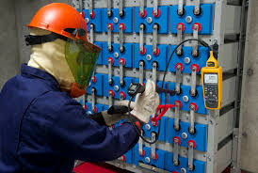
Testing Criteria

Slide 20
Overview of UL 9540 Tests
EES system tech-nology tests
Normal operations
Dielectric voltage withstand
Equipment grounding and bonding
Insulation resistance
Mechanical tests
Over speed
Faulted securement
Fluid containment tests
Leakage
Strength
Environ-mental tests
Impulse
Blocked shaft
Special Environment Installations
Electric tests
5 Maximum Abnormal Operating Speed
Mechanical Failure Qualification (production)
Notes:
Although most testing would be covered by the technology specific standards, UL 9540 does include some testing for those technologies that may lack specific criteria. As noted above, the tests are divided into electrical tests, mechanical tests fluid containment tests and environmental tests.

Slide 21
Summary
UL 9540 was the world’s first safety standard published to address energy storage systems
It is the national standard for energy storage system safety in the United States and Canada, and is influencing designs of products being deployed around the globe today
Connections with IEC TC120 and others will support the best use of the UL 9540 effort to address global safety

Slide 22
Thank you
Ngiyabonga
Dankie
Ken Boyce
Kenneth.p.boyce@ul.com

